Slide 1

RCL
Program Help

Slide 2
The program interface.
The program functions.
How to save and open project?.
Application example.
End the RCL Programe Help.

Slide 3
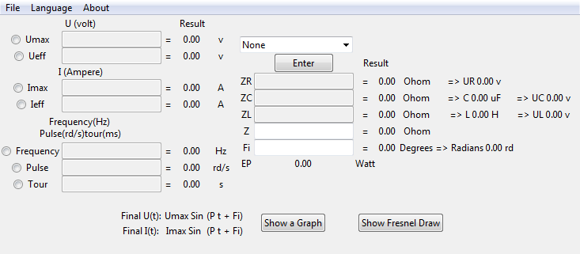
The program interface
General Interface
Next

Slide 4
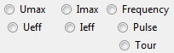
The program interface
Menu Bar
Buttons
Optional
buttons
Back
Next

Slide 5
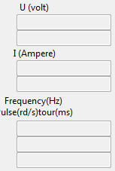
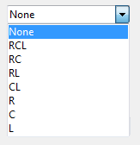
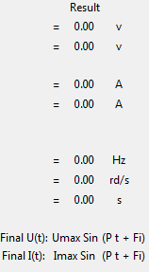
The program interface
Input Box
Combo Box
Result
Back
Home

Slide 6
The program function
General function:
Program for the calculation of values of currents, In circuits (RCL, RC, RL, CL, R, C, L), displays the results in the program, It then creates a graphical representation of current and tension, and Frensel representation of tensions.
Home

Slide 7
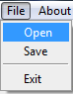
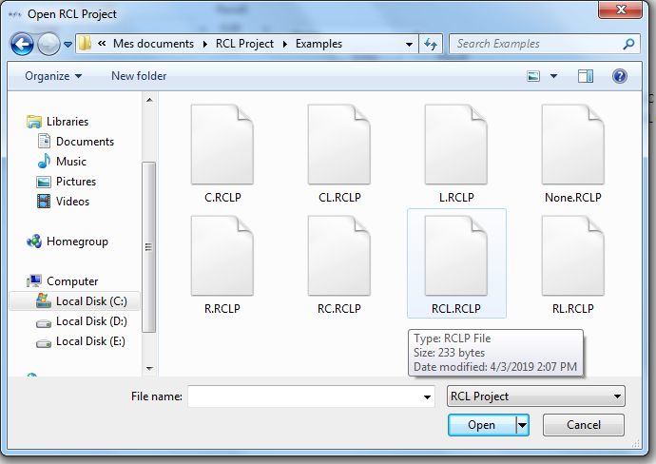
How to save and open project ?
Open projets:
Next

Slide 8
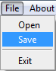
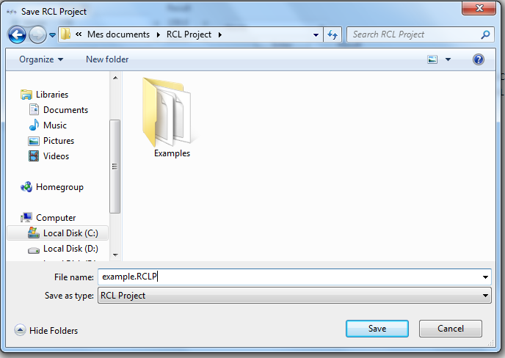
How to save and open project ?
Save projets:
Back
Home

Slide 9
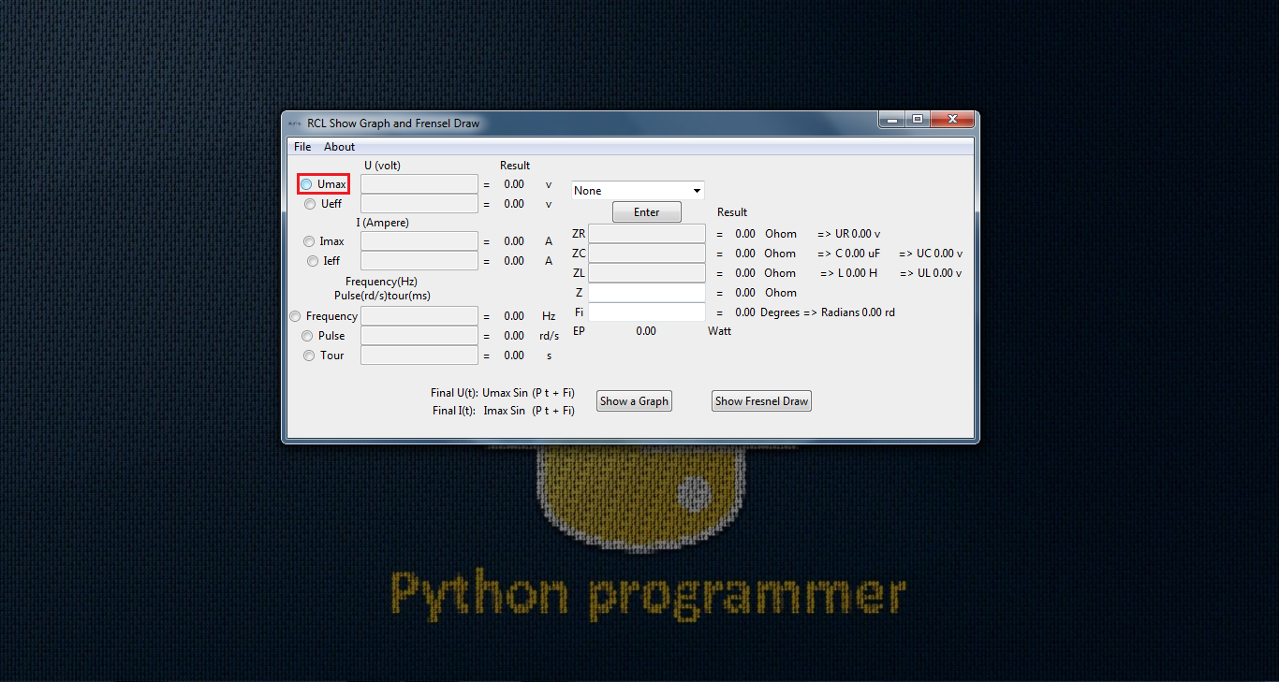
Application example
Home

Slide 10

Application example

Slide 11


Slide 12


Slide 13
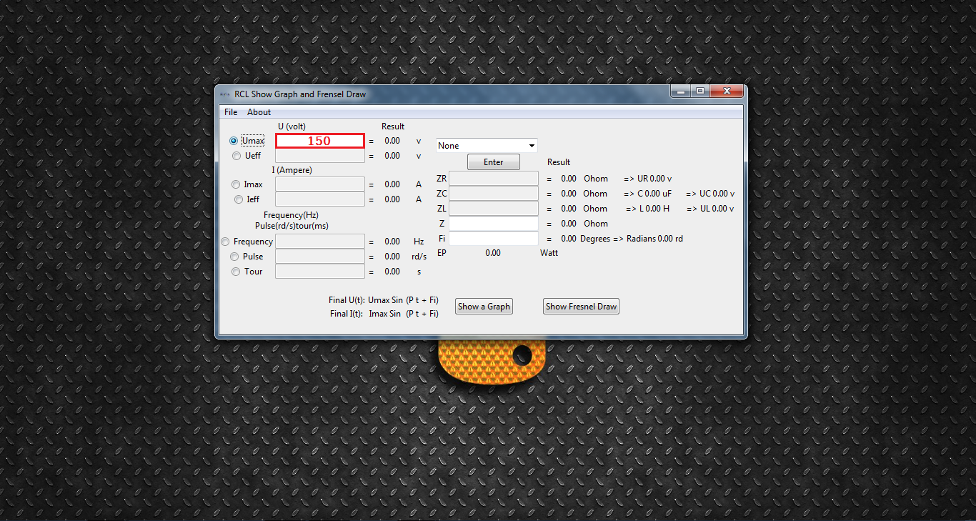

Slide 15
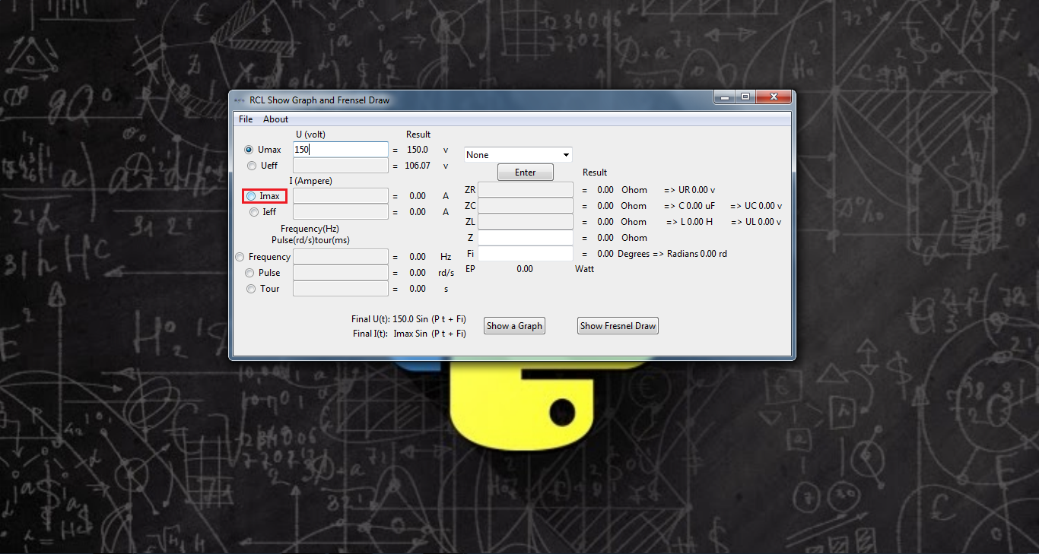

Slide 17
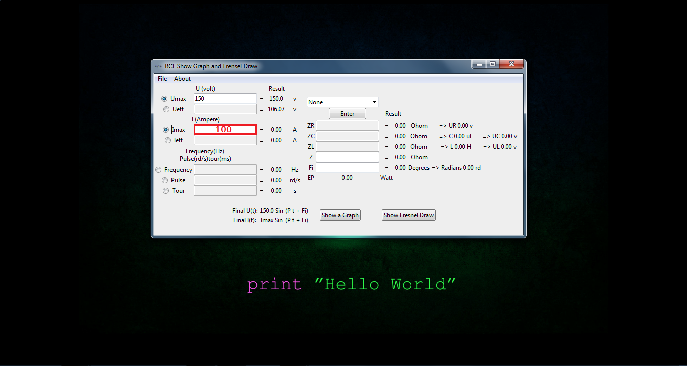

Slide 19
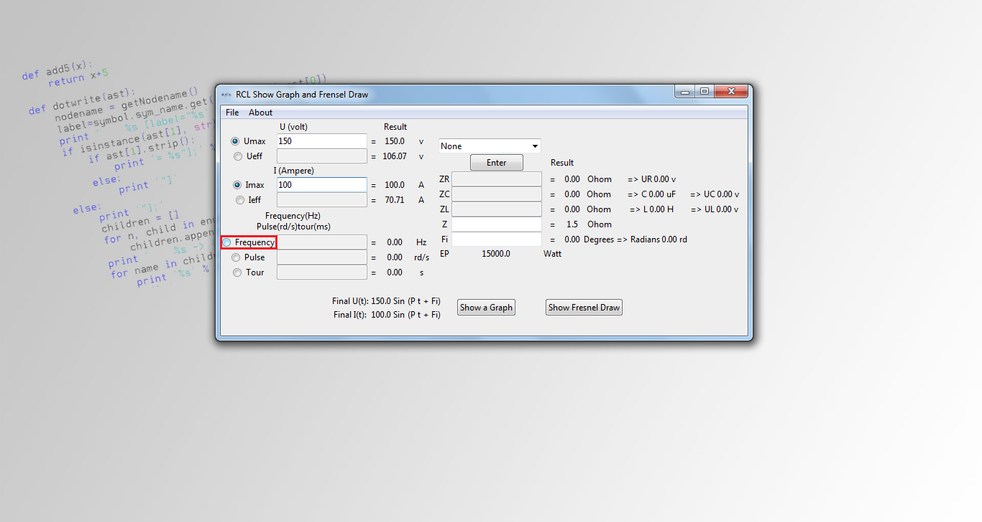

Slide 21
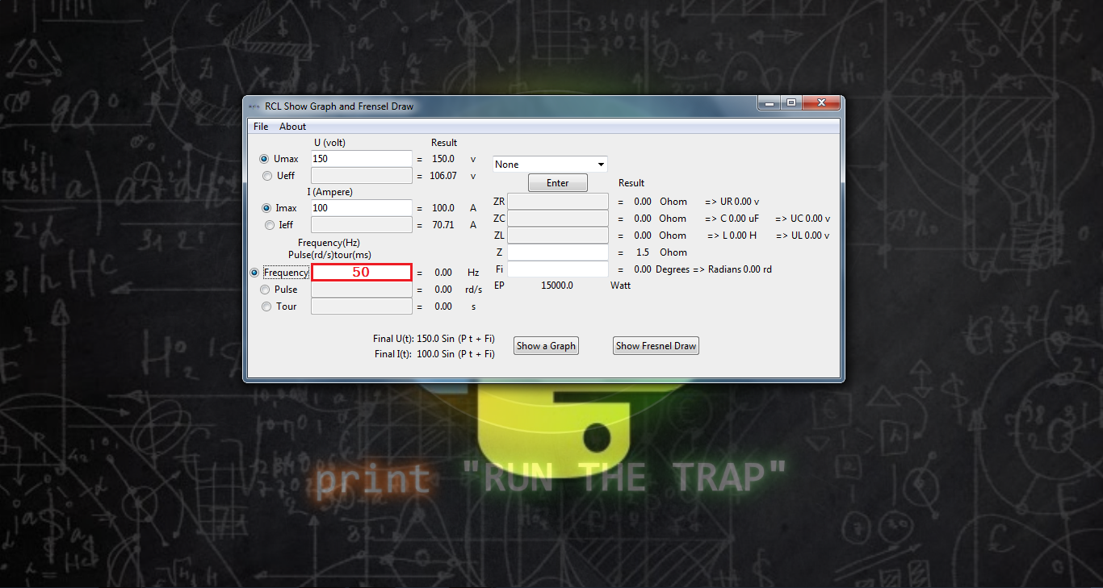

Slide 23
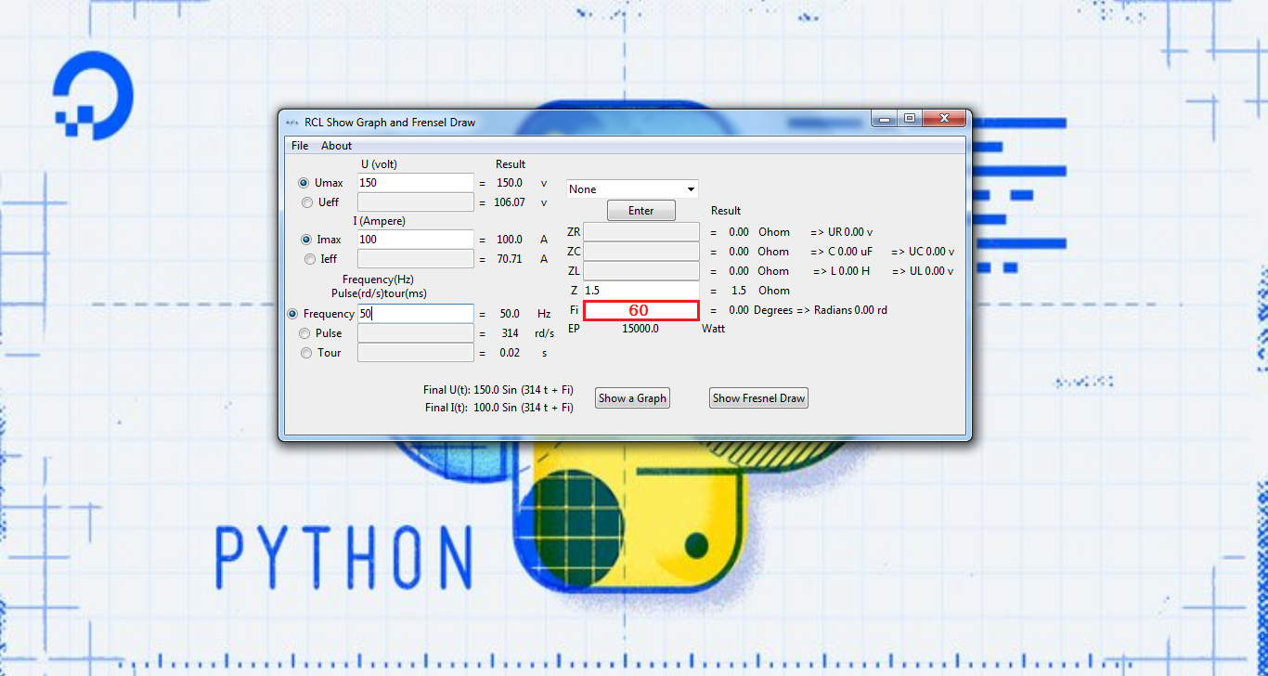

Slide 25
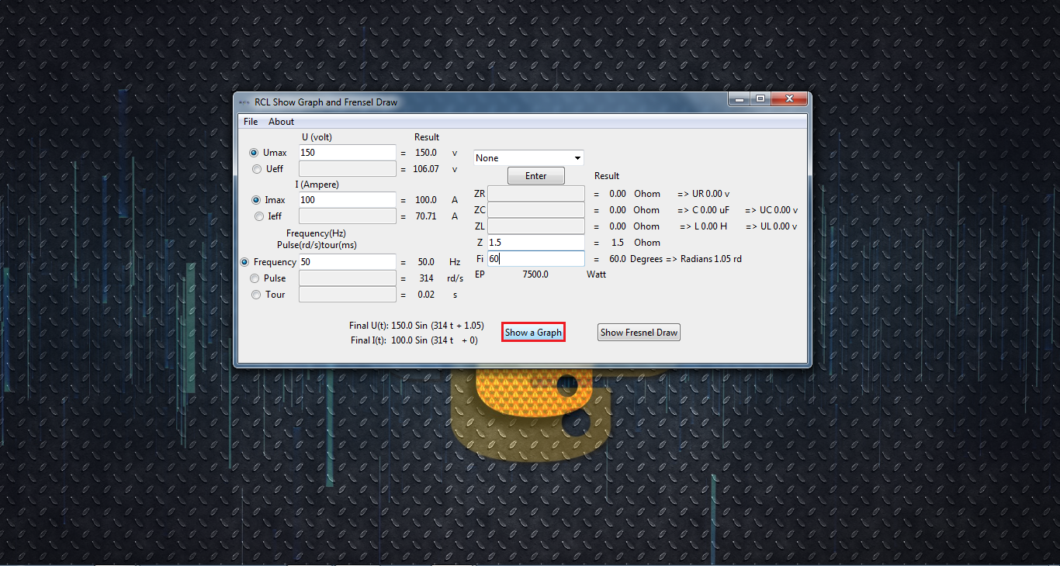

Slide 27
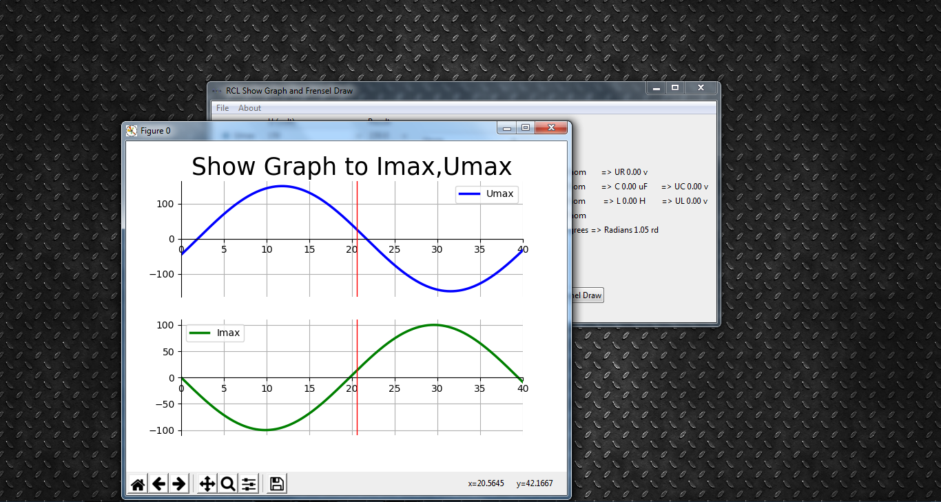

Slide 29
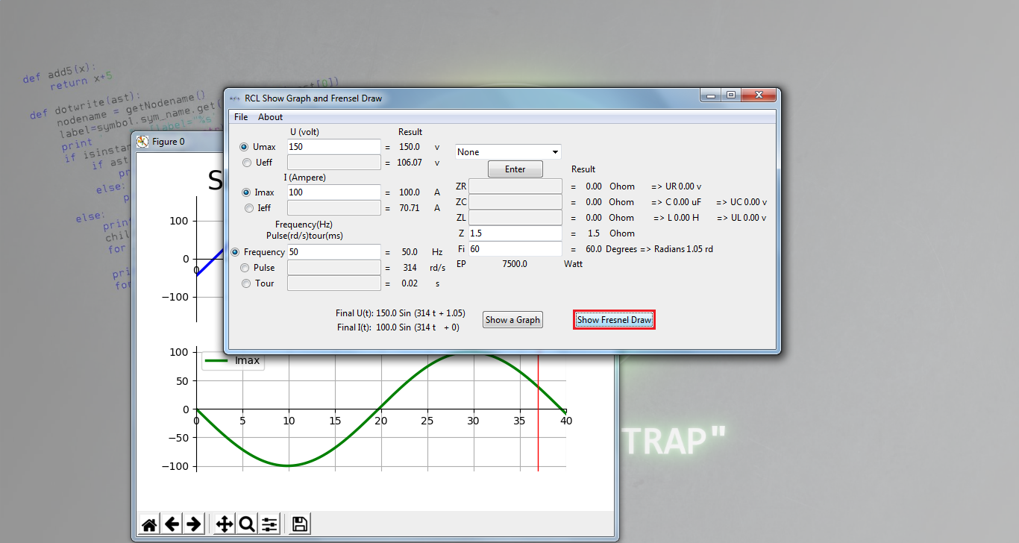

Slide 31
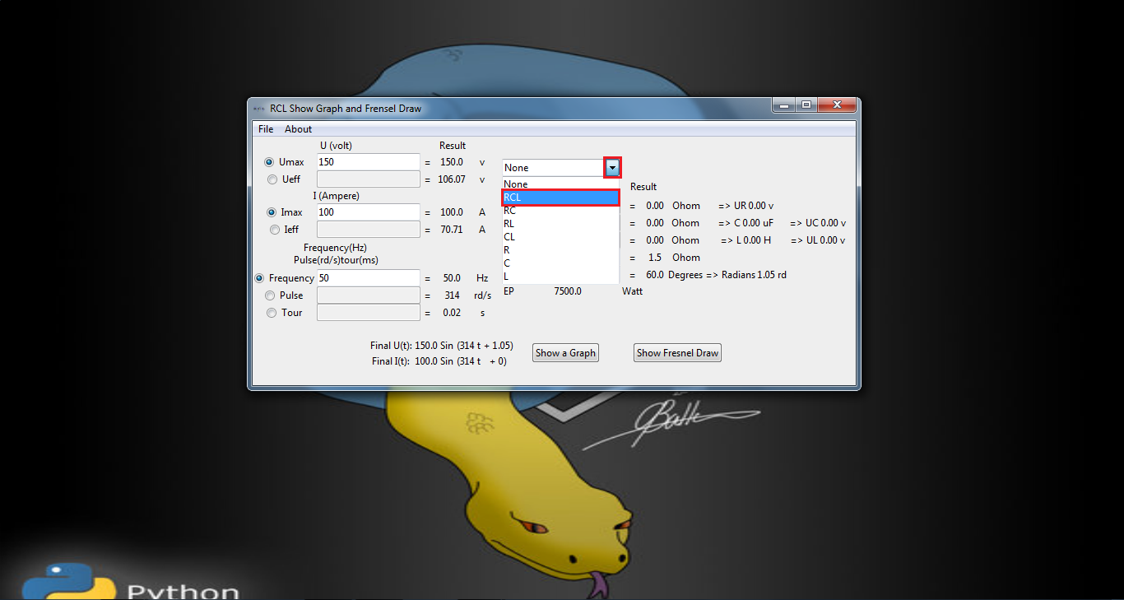

Slide 33
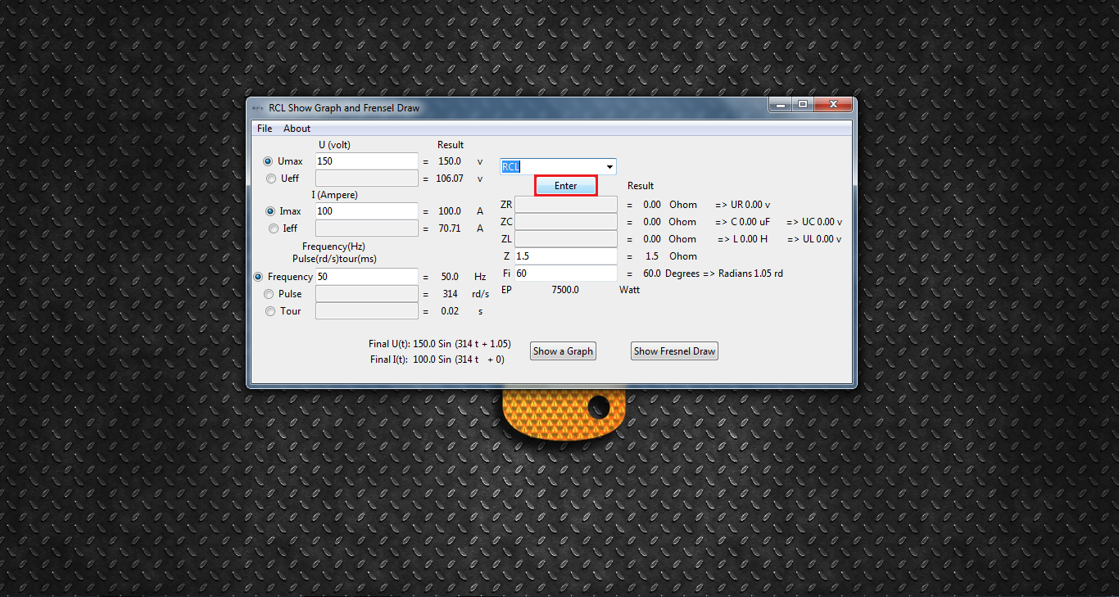

Slide 35
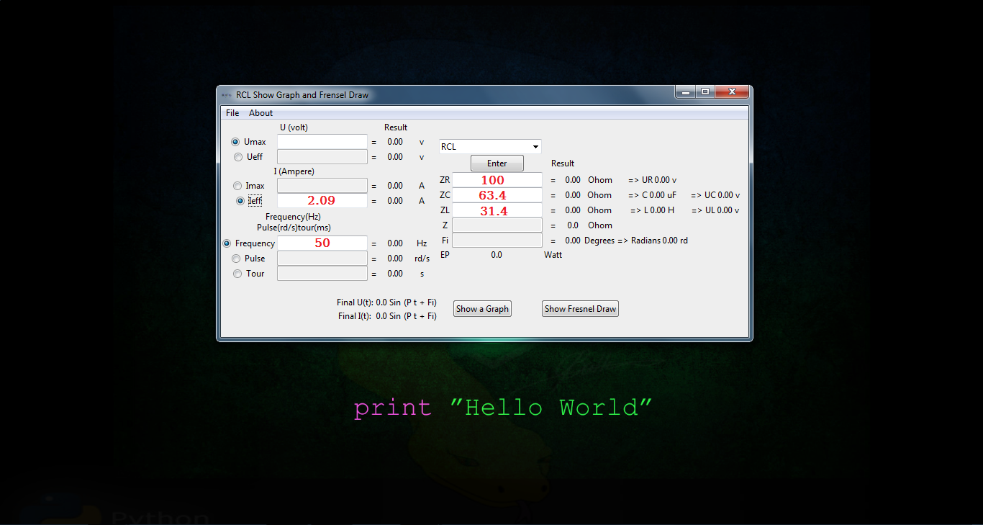

Slide 37
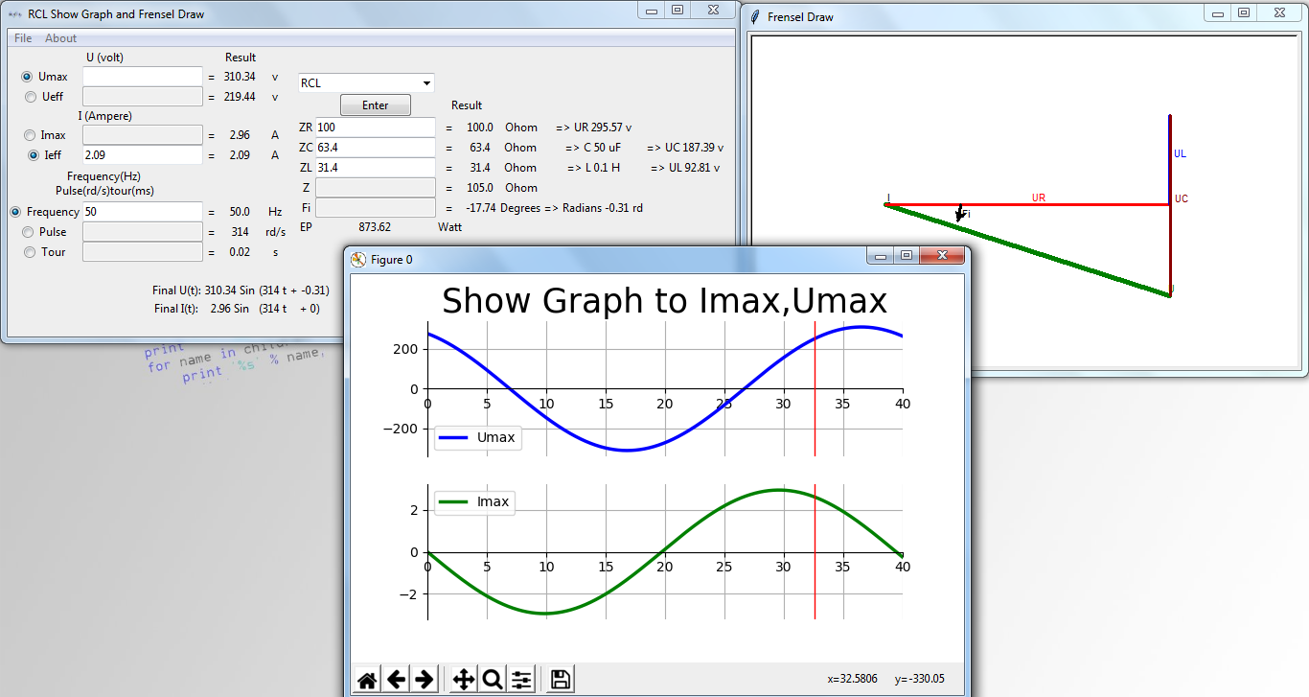

Slide 39
End the RCL Program Help
Please follow me in:
YouTube
Facebook
Blogger
End
Home

